Slide 1
RxJS
Introduction to RxJS
Lecture 1
By James(Jin) Wang
12/05/2021

Slide 2
Outline
What is RxJS?
How is RxJS used in Angular?
What is reactive development?

Slide 3
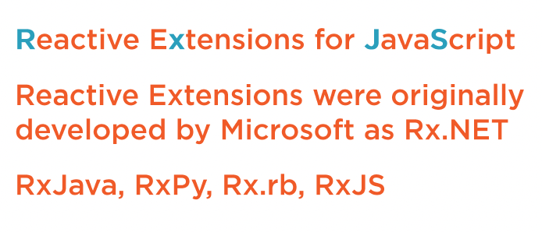
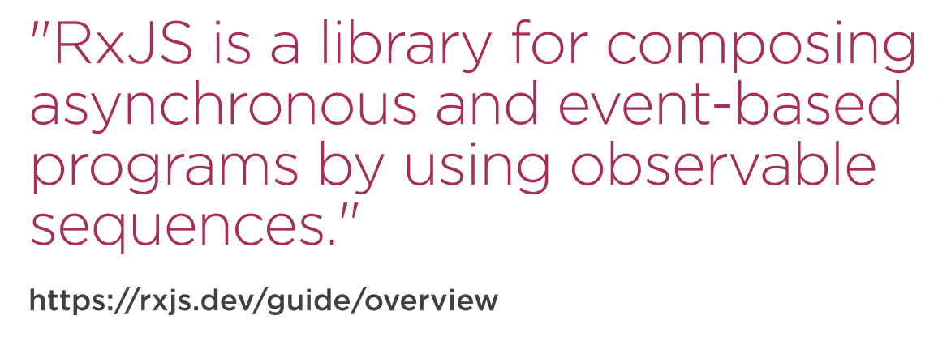
What is RxJS?

Slide 4
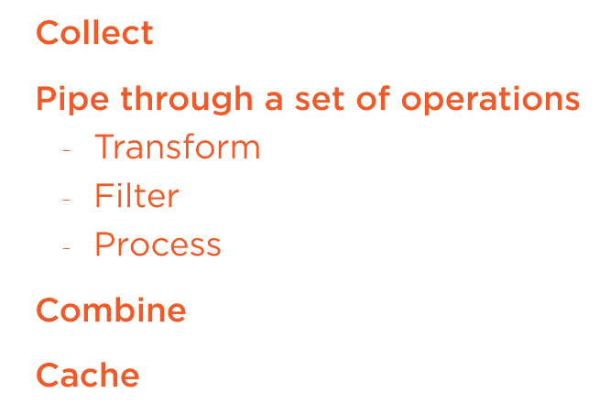
What is RxJS?
  Manage Data as It Flows through Time

Slide 5
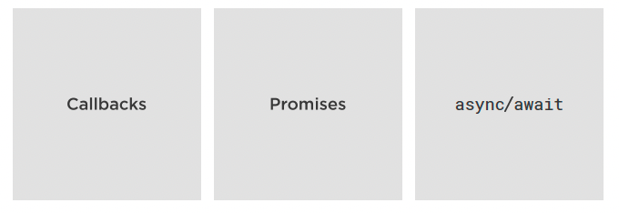
What is RxJS?
  Why RxJS Instead Of…

Slide 6
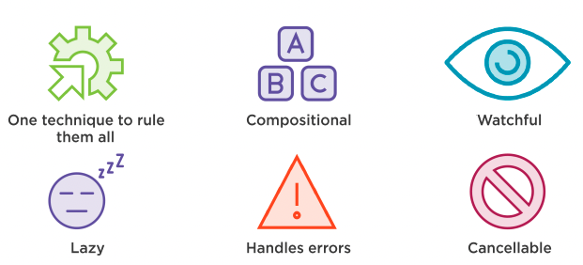
What is RxJS?
  Why RxJS?

Slide 7
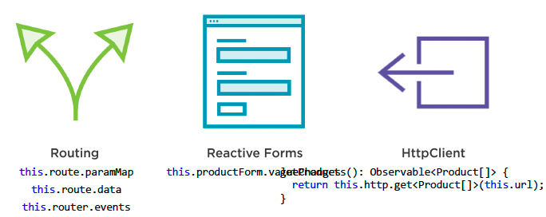
Hiow is RxJS used in Angular?
  How is RxJS used in Angular?

Slide 8
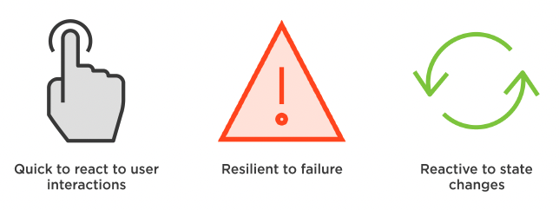
What is Reactive Development?
  Reactive Development

Slide 9
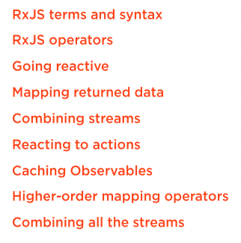
Outline

Slide 10
Summary

Slide 11
Assignment

Slide 12
Self Study
  RxJS: The Big Picture
  https://app.pluralsight.com/library/courses/rxjs-big-picture

